Slide 1

EMAIL SPAM DETECTION
(NLP)

Slide 2
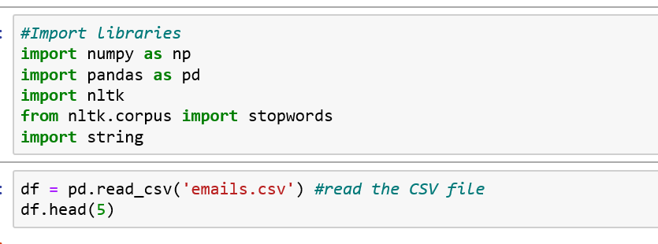

Slide 3
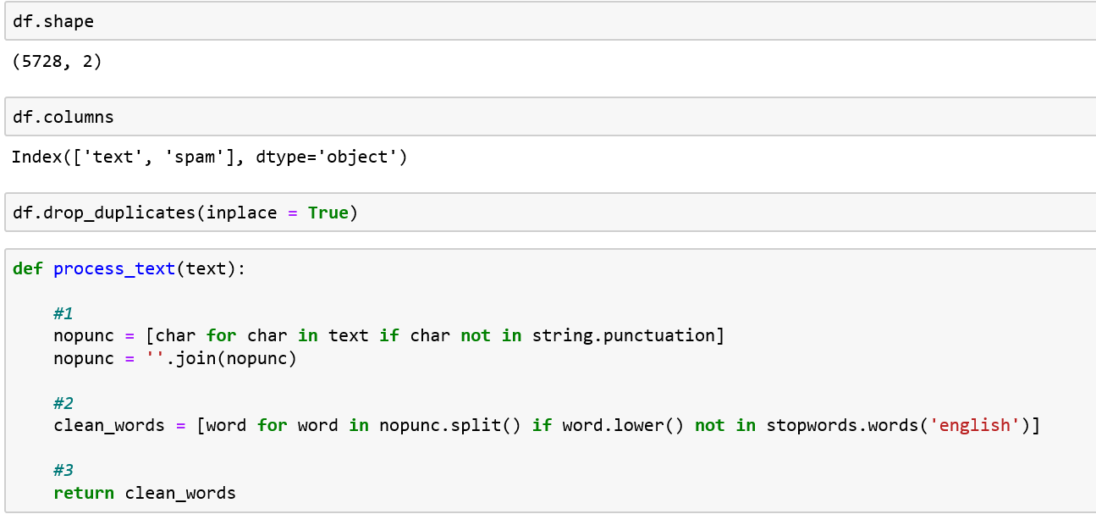

Slide 4


Slide 5
